Slide 1
F
I
R
S
T
C
O
R
N
A
N
I
T
H
I
S
12.12-31
A free CD of this message will be available following the service
It will also be available for podcast later this week at calvaryokc.com

Slide 2
O
A
N
S
12.12-31
I
I
F
I
R
S
T
C
R
N
T
H

Slide 3
Cells
Bones
skin
Motion
O
A
N
S
12.12-31
I
I
F
I
R
S
T
C
R
N
T
H

Slide 4
ME
O
A
N
S
12.12-31
I
I
F
I
R
S
T
C
R
N
T
H

Slide 5
Schism - schisma – to rip or tear
Matt. 9:16 - No one puts a piece of unshrunk cloth on an old garment; for the patch pulls away from the garment, and the tear is made worse.
O
A
N
S
12.12-31
I
I
F
I
R
S
T
C
R
N
T
H

Slide 6
Natural
Talent
Acquired
Given
Skill
Gift
O
A
N
S
12.12-31
I
I
F
I
R
S
T
C
R
N
T
H

Slide 7
Teachers - Eph. 4:11 mentions pastor/teachers
O
A
N
S
12.12-31
I
I
F
I
R
S
T
C
R
N
T
H

Slide 8
Helps – those that serve
Same as the gift of ministry in Romans 12.7
O
A
N
S
12.12-31
I
I
F
I
R
S
T
C
R
N
T
H

Slide 9
Administrations - from a Latin root meaning to pilot or steer
Same as leading in Romans 12.7
O
A
N
S
12.12-31
I
I
F
I
R
S
T
C
R
N
T
H

Slide 10
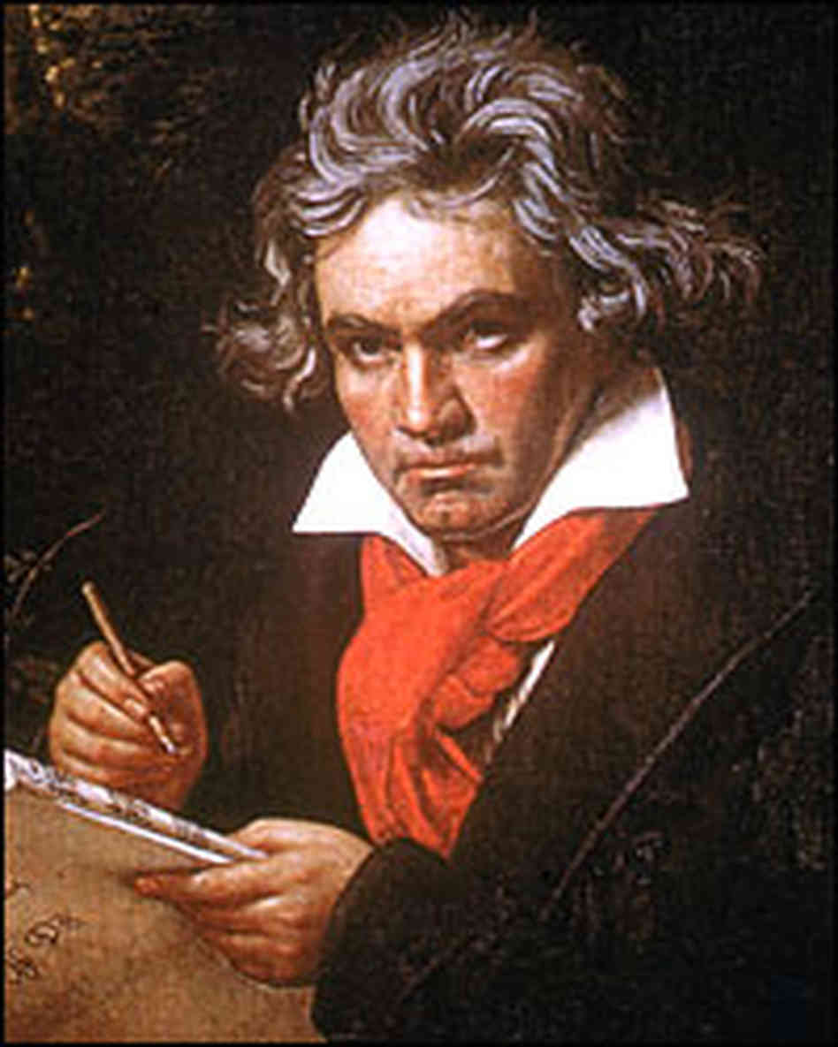
(1770-1827)
O
A
N
S
12.12-31
I
I
F
I
R
S
T
C
R
N
T
H

Slide 11
Phil. 2:12b-13 - ^{12b} Therefore, my beloved, as you have always obeyed, not as in my presence only, but now much more in my absence, work out your own salvation with fear and trembling; ¹³ for it is God who works in you both to will and to do for His good pleasure.
O
A
N
S
12.12-31
I
I
F
I
R
S
T
C
R
N
T
H

Slide 12
I asked God to take away my pride.
God said, “No. It is not for me to take away, but for you to give it up.”
I asked God to make my handicapped child whole.
God said, “No. His spirit is whole, his body is only temporary.”
O
A
N
S
12.12-31
I
I
F
I
R
S
T
C
R
N
T
H

Slide 13
I asked God to grant me patience.
God said, “No. Patience is a by-product of tribulations; it isn't granted, it is learned.”
I asked God to give me happiness
God said, “No. I give you blessings, happiness is up to you.”
O
A
N
S
12.12-31
I
I
F
I
R
S
T
C
R
N
T
H

Slide 14
I asked God to spare me pain.
God said, “No. Suffering draws you apart from worldly cares and brings you closer to me.”
I asked God for all things that I might enjoy life.
God said, “No. I will give you life so that you may enjoy all things.”
O
A
N
S
12.12-31
I
I
F
I
R
S
T
C
R
N
T
H

Slide 15
I asked God to help me LOVE others, as much as he loves me.
God said, “Ahhhh ... now you’ve got the idea!”
O
A
N
S
12.12-31
I
I
F
I
R
S
T
C
R
N
T
H

